Slide 1
AWS

Slide 2
Serverless Overview

Slide 3
What’s serverless?
• Serverless is a new paradigm in which the developers don’t have to manage servers anymore…
• They just deploy code
• They just deploy… functions !
• Initially... Serverless == FaaS (Function as a Service)
• Serverless was pioneered by AWS Lambda but now also includes
anything that’s managed: “databases, messaging, storage, etc.”
• Serverless does not mean there are no servers…
it means you just don’t manage / provision / see them

Slide 4
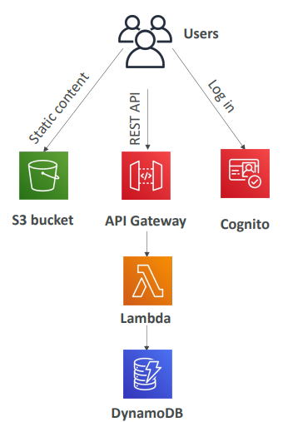
Serverless in AWS
• AWS Lambda • DynamoDB • AWS Cognito • AWS API Gateway • Amazon S3 • AWS SNS & SQS • AWS Kinesis Data Firehose • Aurora Serverless • Step Functions • Fargate

Slide 5
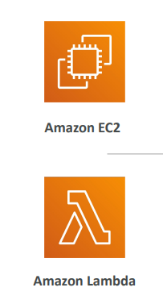
Why AWS Lambda
• Virtual Servers in the Cloud
• Limited by RAM and CPU
• Continuously running
• Scaling means intervention to add / remove servers
• Virtual functions – no servers to manage!
• Limited by time - short executions
• Run on-demand
• Scaling is automated!

Slide 6
Event-Driven Execution:
Lambda is an event-driven service, meaning that it runs your code in response to certain triggers or events.
These events can come from many different AWS services like
S3 (file uploads),
DynamoDB (database changes),
API Gateway (HTTP requests),
CloudWatch (scheduled events), etc.

Slide 7
AWS Lambda language support
• Node.js (JavaScript)
• Python
• Java
• C# (.NET Core) / Powershell
• Ruby
• Custom Runtime API (community supported, example Rust or Golang)
• Lambda Container Image
The container image must implement the Lambda Runtime API
ECS / Fargate is preferred for running arbitrary Docker images

Slide 8
Benefits of AWS Lambda
• Easy Pricing:
Pay per request and compute time
Free tier of 1,000,000 AWS Lambda requests and 400,000 GBs of compute time
• Integrated with the whole AWS suite of services
• Event-Driven: functions get invoked by AWS when needed
• Integrated with many programming languages
• Easy monitoring through AWS CloudWatch
• Easy to get more resources per functions (up to 10GB of RAM!)
• Increasing RAM will also improve CPU and network!

Slide 9
AWS Lamda Limitations
Execution Time Limit: Lambda functions can only run for a maximum of 15 minutes. If you need longer-running
tasks, Lambda might not be the best choice.
Stateless: Lambda functions don’t keep state between invocations, so they’re best for tasks that don’t require
long-term memory.
Cold Start Delays: If a Lambda function hasn’t run in a while, there’s sometimes a slight delay—called a 'cold
start'—when it starts up. This can add a little latency, but AWS provides ways to mitigate it for critical functions.

Slide 10
When to use Lambda?
"Image Processing: Let’s say users upload images to your app. You can set up Lambda to
automatically resize, compress, or even apply filters to each image as it’s uploaded."
"Data Transformation: If you need to clean up or process data before storing it in a database,
a Lambda function can handle that transformation automatically."
"Real-Time Notifications: If an event happens—like a new user signing up—you can use
Lambda to trigger an email, SMS, or other notifications instantly."

